Slide 1
Unit V
Introduction to Content Management System(CMS)
-Binayak Maharjan

Slide 2
5.1 Content Management System
A Content Management System (CMS) is a software application that allows users to create, manage, and publish digital content, often without the need for extensive coding knowledge. It acts as a central hub for organizing, editing, and publishing content across various digital platforms, such as websites and apps.
CMS are typically used for Enterprise Content Management (ECM) and Web Content Management (WCM) and have two components:
Content Management Application (CMA):
The CMA is a graphical user interface (GUI) that allows the user to control the creation, modification and removal of content from a website without needing to know anything about HTML.
Content Delivery Application (CDA):
The CDA component provides the back-end services that support management and delivery of the content once it has been created in the CMA.

Slide 3
5.1 Content Management System
Key Features and Functionality:
Content Creation and Management:
CMSs provide a user-friendly interface for creating, editing, and modifying digital content, including text, images, and other media.
Collaboration:
Many CMSs support multiple users, enabling teams to collaborate on content creation and editing.
Organization and Structure:
CMSs help organize content through features like categories, tags, and hierarchies.
Version Control:
Many CMSs offer version control, allowing users to revert to previous versions of content.

Slide 4
5.1 Content Management System
Workflow Management:
CMSs can implement workflows that define the stages of content creation and publication, assigning roles and responsibilities to different users.
Publication and Distribution:
CMSs facilitate the publication of content to various digital channels, including websites, blogs, and social media platforms.
User-Friendly Interface:
CMSs are designed to be easy to use, even for those without technical expertise.
Scalability and Flexibility:
CMSs can be adapted to various organizational needs and scales, from small websites to large online platforms.

Slide 5

5.1 Overview of Popular CMS Platforms
Wordpress
What it is: WordPress started as a simple blogging platform in 2003 but has evolved into the most popular CMS globally, powering over 40% of all websites on the internet. It's known for its ease of use, flexibility, and vast ecosystem.
Key Features:
User-Friendly Interface: Its intuitive dashboard and block-based editor (Gutenberg) make it incredibly easy for beginners to create and publish content, even without any coding knowledge.
Extensive Themes and Plugins: This is arguably WordPress's biggest strength. There are tens of thousands of free and premium themes (for design) and plugins (for functionality) available. Whether you need an e-commerce store (WooCommerce), SEO optimization (Yoast SEO), contact forms, or image galleries, there's likely a plugin for it.

Slide 6
5.1 Overview of Popular CMS Platforms
SEO Friendly: WordPress is designed with search engine optimization in mind, offering features and plugins that help your site rank higher in search results.
Scalability: While often associated with small blogs, WordPress can handle large, complex websites and high traffic with proper optimization and hosting.
Large Community Support: Due to its immense popularity, WordPress has a massive global community. This means abundant documentation, tutorials, forums, and developers available for support.
Cost-Effective: The core WordPress software is free and open-source. Costs typically come from hosting, premium themes/plugins, and professional development.
Common Use Cases:
Blogs and Personal Websites: Its origins as a blogging platform still make it excellent for this purpose.
Small to Medium Business Websites: Easy to set up and manage informational websites for local businesses

Slide 7
5.1 Overview of Popular CMS Platforms
E-commerce Stores: With the WooCommerce plugin, it's a popular choice for online shops of all sizes.
Portfolios: Artists, photographers, and freelancers often use it to showcase their work.
News and Magazine Sites: Can manage large volumes of content.
Considerations:
Security: Due to its popularity, WordPress is a frequent target for hackers. Regular updates, strong passwords, and security plugins are crucial.
Dependency on Plugins: While a strength, relying on too many plugins can sometimes lead to performance issues or conflicts.

Slide 8
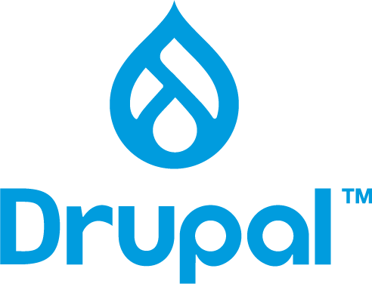
5.1 Overview of Popular CMS Platforms
Drupal
What it is: Drupal is a highly powerful, flexible, and robust open-source CMS often favored by developers and large organizations for complex, data-intensive, and highly customized websites. It's known for its strong security and scalability.
Key Features:
Robust and Secure: Drupal has a dedicated security team and is often chosen for government, enterprise, and financial websites where security is paramount.
Highly Flexible and Customizable: It offers a sophisticated system for content types, fields, and views, allowing for granular control over data structures and presentation. This makes it ideal for unique and complex functionalities.
Scalability for Enterprise: Built to handle large amounts of content and high traffic, making it suitable for large organizations and complex web applications.

Slide 9
5.1 Overview of Popular CMS Platforms
Excellent Multilingual Support: Drupal has robust built-in capabilities for creating and managing multilingual websites, without requiring additional plugins.
API-first Architecture: Its API-driven approach makes it excellent for "headless CMS" setups, where Drupal manages content on the backend, and various front-end applications (mobile apps, single-page applications) consume that content.
Strong User Access Control: Offers very detailed and flexible user permissions and roles.
Common Use Cases:
Government Websites: Many government agencies globally use Drupal for its security and complex content management capabilities.
Large Enterprise Websites: Ideal for corporations needing highly customized platforms.
Universities and Educational Institutions: Managing diverse content and user roles.
Intranets and Extranets: Secure internal and external portals for organizations.
Complex Web Applications: When you need more than just a standard website, such as a community platform, a complex directory, or a reservation system.

Slide 10
5.1 Overview of Popular CMS Platforms
Considerations:
Steeper Learning Curve: Drupal is considerably more complex than WordPress or Joomla. It often requires development knowledge to fully utilize its power.
Cost of Development: While open-source, custom Drupal development can be more expensive due to the higher technical expertise required.
Fewer Themes/Modules than WordPress: While extensive, its ecosystem of pre-built themes and modules is smaller than WordPress's.

Slide 11
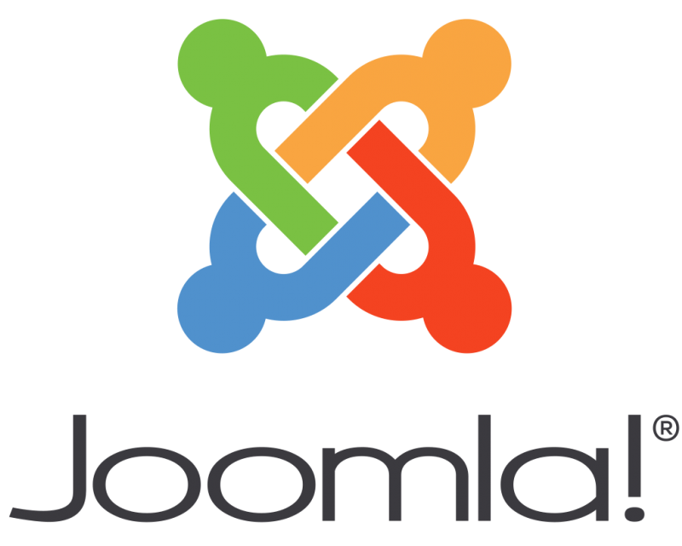
5.1 Overview of Popular CMS Platforms
Joomla
What it is: Joomla is another popular open-source CMS that sits somewhat in the middle between the user-friendliness of WordPress and the developer-centric power of Drupal. It offers a good balance of features, flexibility, and ease of use.
Key Features:
Good Balance of Ease of Use and Power: It's more complex than WordPress but generally more approachable than Drupal for non-developers who want more built-in features than WordPress offers out of the box.
Built-in Multilingual Support: Like Drupal, Joomla provides native multilingual capabilities, making it easier to create sites in multiple languages without needing extensive third-party extensions.
Robust Access Control List (ACL): Offers detailed user permissions and access control, similar to Drupal, allowing you to manage different user groups effectively.

Slide 12
5.1 Overview of Popular CMS Platforms
Extensible through Extensions: It has a large directory of extensions (components, modules, plugins, and templates) to add functionality, though not as vast as WordPress.
MVC Framework: Built on a Model-View-Controller (MVC) web application framework, which can appeal to developers who prefer this architectural pattern.
Common Use Cases:
Business Websites: Good for small to medium businesses that need more structured content or specific functionalities than a simple blog.
Corporate Intranets/Extranets: Its ACL and user management features make it suitable.
Online Magazines and Publications: Can manage various content types and authors.
E-commerce Sites: While not as direct as WooCommerce, extensions like VirtueMart enable e-commerce.
Community Portals: Sites requiring user interaction and varied content types.

Slide 13
5.1 Overview of Popular CMS Platforms
Considerations:
Moderate Learning Curve: Steeper than WordPress, but less steep than Drupal. The admin interface can sometimes feel less intuitive than WordPress.
Fewer Extensions than WordPress: While substantial, its extension library isn't as vast, which might mean custom development for very niche requirements.
Less Market Share: While still popular, its market share has declined over the years compared to WordPress.

Slide 14
5.2 Advantages of Using CMS in Web Development
Non-Technical Content Management: Allows non-developers to create, edit, and publish website content easily.
Rapid Development & Deployment: Accelerates website creation due to pre-built functionalities, themes, and plugins.
Cost-Effectiveness: Often open-source and free, reducing initial software expenditure.
Streamlined Updates: Simplifies content revisions, scheduling, and version control.
Extensibility & Feature-Rich: Provides a vast ecosystem of plugins/modules to add functionality without custom coding.
Improved SEO: Offers built-in tools and structures that assist in search engine optimization.
Scalability: Supports website growth from small projects to large, complex platforms.
Strong Community Support: Access to extensive documentation, forums, and resources from a large user base.
Enhanced Security: Regular updates and built-in features help protect against common vulnerabilities.
Collaborative Workflow: Facilitates multi-user access with distinct roles and permissions for team management.

Slide 15
5.3 Use Cases and Scenarios of CMS
1. Blogs and Personal Websites
Scenario: An individual wants to publish articles, share insights, or showcase a personal portfolio.
CMS Use: Provides easy interfaces for creating posts, managing categories, uploading media, and handling comments without needing coding skills.
2. Business Websites
Scenario: A small to medium-sized business needs an online presence to detail services, display products, share company information, and offer contact options.
CMS Use: Enables dynamic content updates for services, testimonials, and company news, often integrating contact forms and basic SEO tools.

Slide 16
5.3 Use Cases and Scenarios of CMS
3. E-commerce Stores
Scenario: A business aims to sell products online, managing inventory, processing orders, and handling secure payments.
CMS Use: Dedicated e-commerce platforms or CMS extensions provide comprehensive tools for product catalogs, shopping carts, order fulfillment, and customer account management.
4. News Portals and Online Magazines
Scenario: A publishing entity needs to rapidly publish articles, editorials, and multimedia content, often with multiple contributors.
CMS Use: Facilitates robust publishing workflows, content categorization, scheduling, and user role management for efficient content delivery.

Slide 17
5.3 Use Cases and Scenarios of CMS
5. Government and Public Sector Websites
Scenario: A government agency or municipal office needs to disseminate public notices, regulations, services, and official communications to citizens.
CMS Use: Offers high security, stringent user permissions, accessibility features, and document management for reliable public information.
6. Educational Institutions
Scenario: A school, college, or university requires a platform for course catalogs, faculty directories, admission information, and student resources.
CMS Use: Supports event management, secure content areas for students/staff, and integration with academic systems.

Slide 18
5.3 Use Cases and Scenarios of CMS
7. Non-Profit Organizations
Scenario: An NGO needs to share its mission, project updates, success stories, and facilitate fundraising or volunteer sign-ups.
CMS Use: Enables easy updates of mission statements, event calendars, donation forms, and multimedia showcases of impact.
8. Membership and Community Sites
Scenario: An organization wants to build an exclusive online space where members can access restricted content, participate in forums, or manage profiles.
CMS Use: Manages user registration, content access based on membership levels, and often integrates forum or social networking features.

Slide 19
5.3 Use Cases and Scenarios of CMS
9. Corporate Intranets/Extranets
Scenario: A large company requires an internal portal for employees to access news, policies, shared documents, or an external portal for partners to collaborate.
CMS Use: Provides secure access control, document versioning, knowledge bases, and integration with existing enterprise tools.
10. Multi-site Management
Scenario: An entity needs to manage several distinct websites (e.g., for different brands, regions, or departments) from a centralized administration.
CMS Use: Specific features allow managing multiple websites from a single CMS installation, streamlining maintenance and content synchronization.

Slide 20
5.3 Use Cases and Scenarios of CMS
11. Headless CMS for Modern Applications
Scenario: A company is building a mobile app, a website, and potentially other digital displays, all requiring consistent content.
CMS Use: The CMS serves as a content repository, delivering content via APIs to any frontend application, providing ultimate flexibility for omnichannel experiences.

Slide 21
5.4 Brief About Web Programming Frameworks
A framework in programming is a predefined set of tools, libraries, and best practices that provides a structured foundation for developing software applications. It simplifies the development process by handling common tasks and enforcing consistent patterns.
A web framework (WF) or web application framework (WAF) is a software framework that is designed to support the development of web applications including web services, web resources and web APIs.
Web frameworks aim to alleviate the overhead associated with common activities performed in web development. For example, many web frameworks provide libraries for database access, templating frameworks and session management, and they often promote code reuse.

Slide 22
5.4 Brief About Web Programming Frameworks
Key Characteristics of a Framework:
Reusable code: Comes with pre-written modules for common functionalities.
Inversion of Control (IoC): Unlike libraries that you call, a framework often calls your code — this is called the "Hollywood Principle": "Don't call us, we'll call you."
Predefined architecture: Enforces a consistent structure (e.g., MVC).
Built-in components: Often includes components for routing, database access, session handling, security, etc.
Analogy:
Think of a framework as a template for building a house. The foundation, wiring, and plumbing are already set up—you just design the rooms and add furniture (your custom code).

Slide 23

5.4 PHP Frameworks
1. Laravel
Overview: Laravel is the most popular PHP framework, known for its elegant syntax and robust features like routing, authentication, caching, and sessions.
Pros:
Clean and expressive syntax (MVC architecture).
Built-in authentication, routing, and queueing.
Strong community and abundant learning resources.
Artisan CLI for automation.
Eloquent ORM for database interaction.
Cons:
Heavyweight for small applications.
Steep learning curve for beginners.

Slide 24
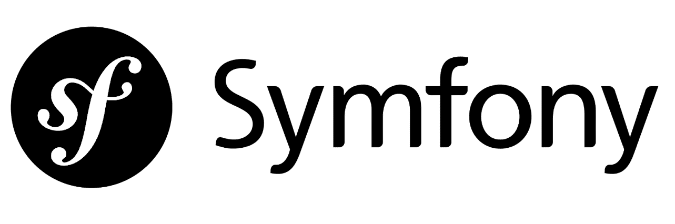
5.4 PHP Frameworks
2. Symfony
Overview: Symfony is a flexible, scalable framework used for large-scale enterprise applications. It follows PHP standards strictly.
Pros:
Highly customizable and reusable components.
Good for complex, large applications.
Long-term support versions.
Integrates well with other platforms.
Cons:
Complex for beginners.
Slower development speed compared to Laravel.
Configuration-heavy.

Slide 25

5.4 PHP Frameworks
3. CodeIgniter
Overview: CodeIgniter is a lightweight and straightforward PHP framework ideal for beginners and rapid development.
Pros:
Easy to install and configure.
Lightweight and fast.
Simple learning curve.
Good documentation.
Cons:
Lacks built-in modularity for larger applications.
Fewer built-in features (you must build many things manually).
Less active development compared to Laravel/Symfony.

Slide 26
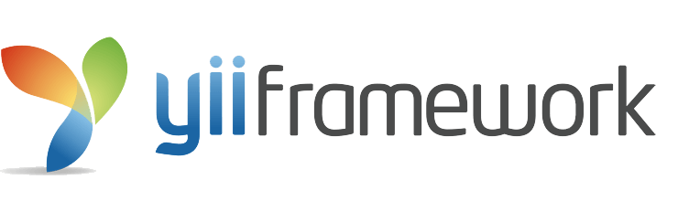
5.4 PHP Frameworks
4. Yii (Yes, it is!)
Overview: Yii is a performance-oriented framework that's suitable for developing high-performance web applications.
Pros:
Fast and efficient (lazy loading).
Gii code generator accelerates development.
Easy to configure and use.
Built-in support for RESTful API development.
Cons:
Smaller community compared to Laravel.
Documentation is not as beginner-friendly.

Slide 27
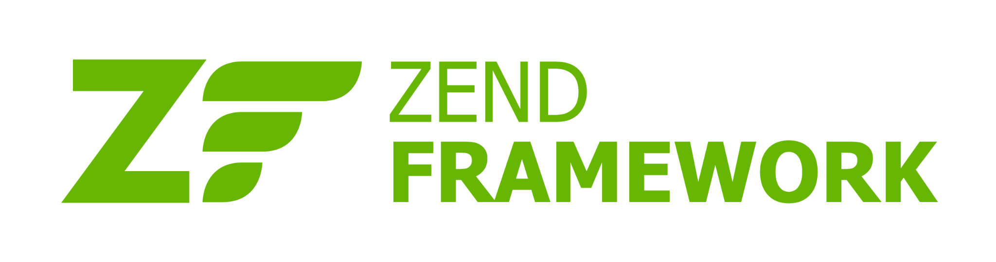
5.4 PHP Frameworks
5. Zend Framework / Laminas Project
Overview: Zend was a robust, enterprise-level framework, now transitioned into the Laminas Project (its open-source successor).
Pros:
Suitable for enterprise-level applications.
Highly customizable and scalable.
Good performance and security.
Cons:
Steep learning curve.
Slower development speed.
Overkill for small to medium projects.

Slide 28

5.4 PHP Frameworks
6. Phalcon
Overview: Phalcon is a high-performance framework implemented as a C extension of PHP.
Pros:
Extremely fast (compiled as a C extension).
Low overhead and high performance.
Clean and secure code base.
Cons:
Difficult to install on shared hosting.
Less documentation and smaller community.
Needs C knowledge for extending functionality.

Slide 29

5.4 PHP Frameworks
7. Slim
Overview: Slim is a minimalistic PHP micro-framework ideal for small web applications and APIs.
Pros:
Lightweight and fast.
Easy to learn and use.
Great for RESTful APIs.
Flexible routing.
Cons:
Limited built-in features.
Not suitable for large-scale applications out of the box.
You must manage many components manually.

Slide 30

5.4 Java Frameworks
1. Spring Framework
Overview: Spring is the most widely used Java framework for building enterprise applications. It supports dependency injection, aspect-oriented programming, and MVC architecture.
Pros:
Modular and flexible (Spring Boot simplifies configuration).
Large community and strong ecosystem.
Supports REST APIs, microservices, security (Spring Security).
Powerful dependency injection (DI) and inversion of control (IoC).
Cons:
Steep learning curve.
XML-based configurations can be complex (less so with Spring Boot).
Can be heavyweight if not modularized properly.

Slide 31

5.4 Brief About Web Programming Frameworks
2. Hibernate
Overview: Hibernate is an object-relational mapping (ORM) framework for Java. It simplifies database interactions by mapping Java classes to database tables.
Pros:
Reduces boilerplate JDBC code.
Automatic table mapping to Java classes.
Database-independent (portable code). Handles lazy loading, caching, and transactions efficiently.
Cons:
Learning curve for complex mappings.
Overhead due to abstraction.

Slide 32

5.4 Brief About Web Programming Frameworks
3. JavaServer Faces (JSF)
Overview: JSF is a Java EE web application framework for building component-based UIs for web apps.
Pros:
Backed by Oracle (standard part of Java EE).
Reusable UI components.
Tool-friendly (integrates well with IDEs like Eclipse).
Cons:
Verbose and complex for simple tasks.
Outdated compared to modern frontend frameworks.
Less flexibility compared to Spring MVC.

Slide 33

5.4 Brief About Web Programming Frameworks
4. Apache Struts
Overview: Struts is an open-source MVC framework for creating enterprise-ready Java web applications.
Pros:
Encourages clean MVC architecture.
Robust validation and tagging support.
Good integration with other Java technologies.
Cons:
Outdated compared to Spring MVC.
Complex configuration and debugging.
Security concerns in older versions.

Slide 34

5.4 Brief About Web Programming Frameworks
5. Grails
Overview: Grails is a web application framework built on top of Spring and Hibernate, using Groovy (a dynamic language for the JVM).
Pros:
Rapid development with less boilerplate.
Convention over configuration.
Full-stack framework with strong plugin support.
Cons:
Smaller community than Spring.
Requires learning Groovy.

Slide 35

5.4 Brief About Web Programming Frameworks
6. Play Framework
Overview: Play is a reactive web framework for Java and Scala, designed for scalability and speed.
Pros:
Asynchronous by default (non-blocking I/O).
REST-friendly and stateless.
Developer-friendly (hot reloads, built-in testing).
Cons:
Less conventional for Java developers used to Spring.
Learning curve due to reactive concepts.
Smaller ecosystem than Spring.

Slide 36

5.4 Python Frameworks
1. Django
Philosophy: "The web framework for perfectionists with deadlines." It emphasizes rapid development and pragmatic design.
Key Features:
ORM (Object-Relational Mapper): A powerful way to interact with databases using Python code, eliminating raw SQL.
Admin Interface: Automatically generated administrative interface for managing data.
Authentication System: Robust user authentication and authorization.
URL Dispatcher: Elegant routing system.
Templating Engine: Django's own powerful template language.
Forms: Comprehensive form handling and validation.
Best For: Large-scale, complex, and database-driven web applications like social networks, e-commerce sites, content management systems, and news portals.

Slide 37

5.4 Python Frameworks
2. Flask
Philosophy: "The microframework for Python based on Werkzeug, Jinja 2 and good intentions." It's explicit about its minimalism.
Key Features:
Werkzeug (WSGI toolkit): Handles basic request/response objects.
Jinja2 (Templating engine): For rendering dynamic HTML.
Extensible: Doesn't dictate database or form libraries; you choose and integrate extensions (e.g., Flask-SQLAlchemy for database, Flask-WTF for forms).
Best For: Small to medium-sized applications, RESTful APIs, microservices, rapid prototyping, and scenarios where you want maximum flexibility and control over the technology stack.

Slide 38
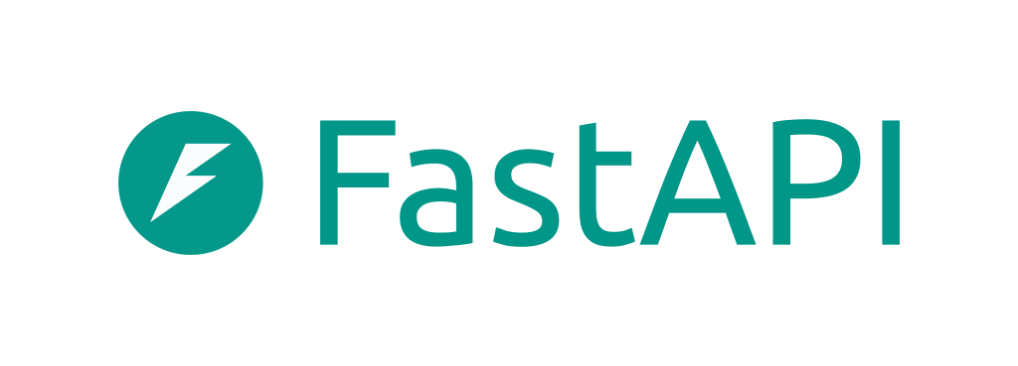
5.4 Python Frameworks
3. FastAPI
Philosophy: "The Modern, Fast (high-performance) web framework for building APIs with Python 3.7+ based on standard Python type hints."
Key Features:
High Performance: Very fast, comparable to Node.js and Go (thanks to Starlette and Pydantic).
Asynchronous Support: Built with async/await for high concurrency.
Automatic Docs: Generates interactive API documentation (Swagger UI and ReDoc) automatically from your code.
Data Validation & Serialization: Uses Pydantic for data validation, serialization, and type checking, reducing errors.
Best For: Building robust and high-performance RESTful APIs, microservices, and WebSockets. Its automatic documentation is a huge plus for collaborative API development.

Slide 39
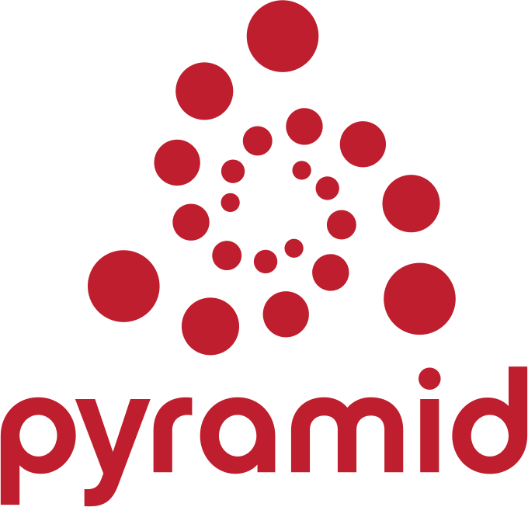
5.4 Python Frameworks
4. Pyramid
Philosophy: "A small, fast, down-to-earth, open source Python web framework." It's designed to be flexible and highly adaptable.
Key Features:
Extremely Flexible: Can be used for very small to very large applications.
No Strong Opinions: Doesn't force specific choices for database, templating, or form libraries.
Authentication & Authorization: Built-in security features.
Scalability: Designed to be highly scalable.
Best For: Developers who prefer significant control over their technology stack, applications with unique requirements, and enterprise-level projects where flexibility is paramount.

